Slide 1
Getting started with the Office 365 APIs

Slide 2

Agenda
Intro to the Office 365 APIs
Getting started
Demos

Slide 3















Vision
EXTEND OFFICE EVERYWHERE
CONNECT TO OFFICE 365 SERVICES
BUILD USING AN OPEN PLATFORM
Delve
z
Users and groups
Files
Mail
Calendar
My Apps
Video Portal
Contacts
Office Graph
Presentations
Documents
Spreadsheets
Lync
OneNote
Yammer

Slide 4
Intro to the Office 365 APIs

Slide 5
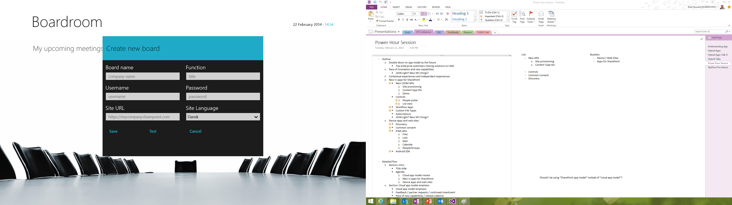
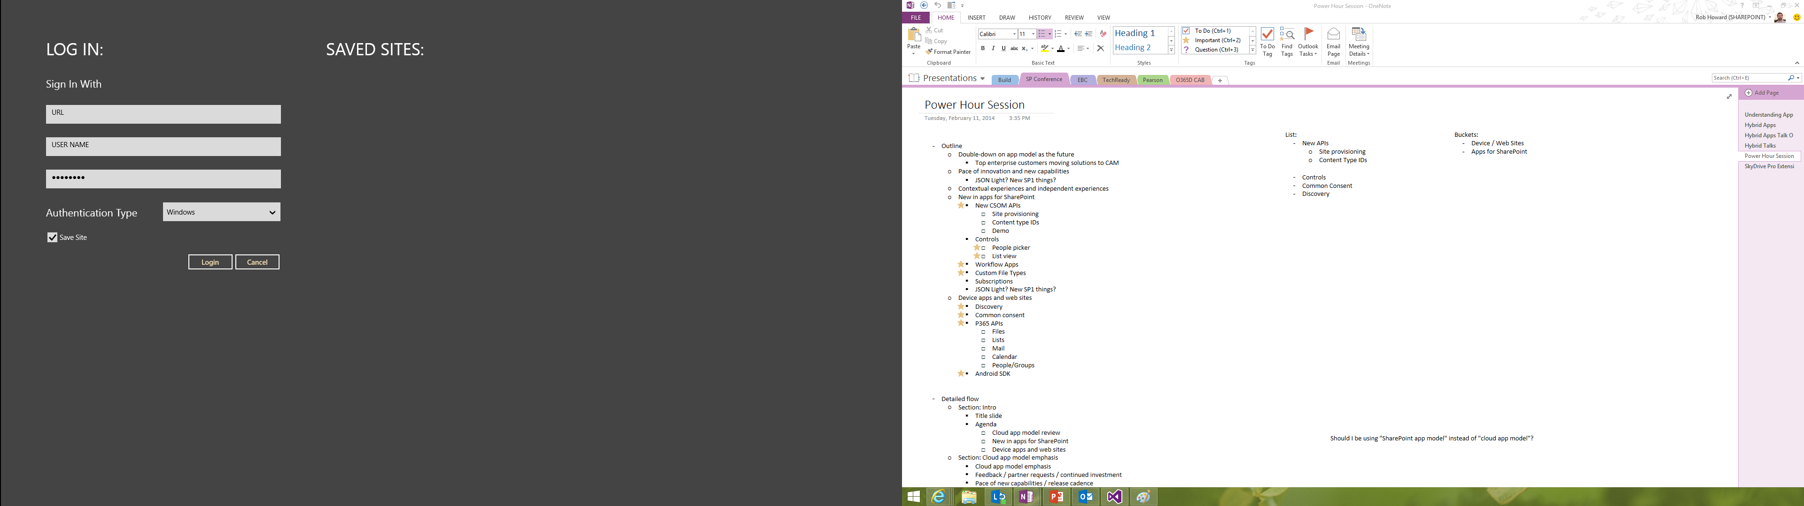
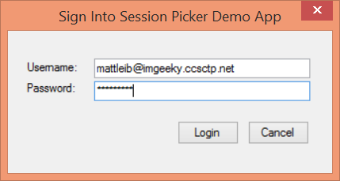
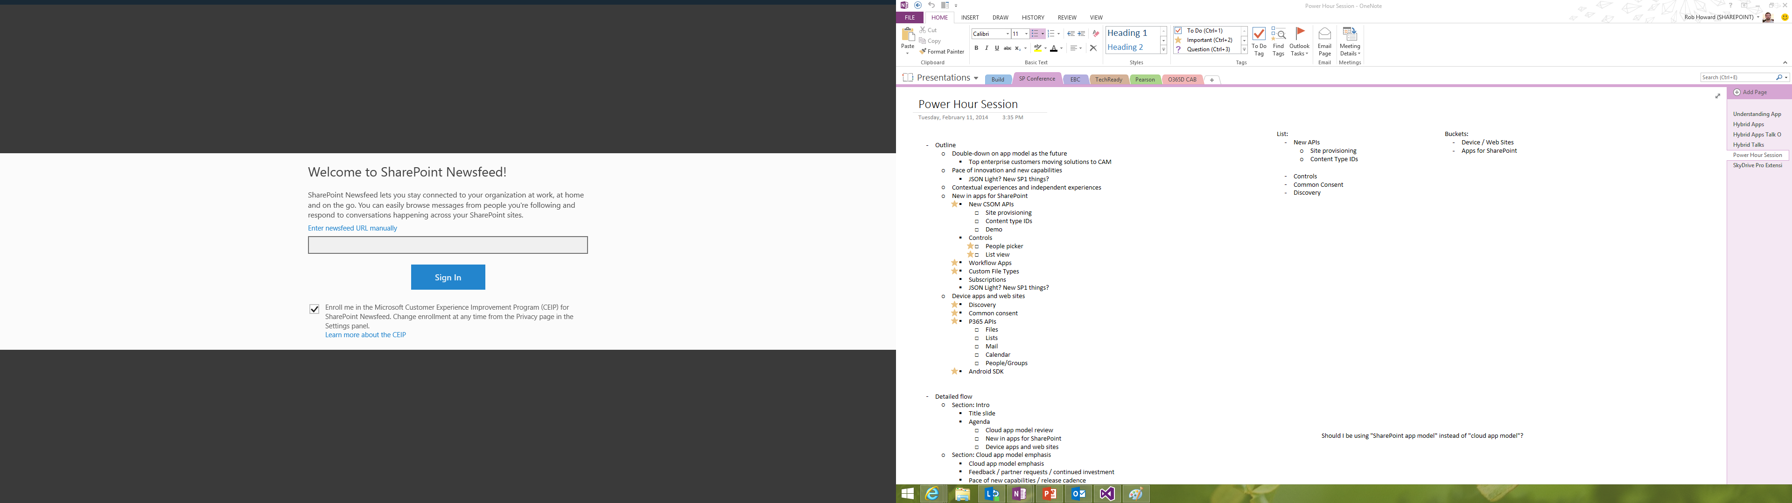
Office 365 device apps

Slide 6
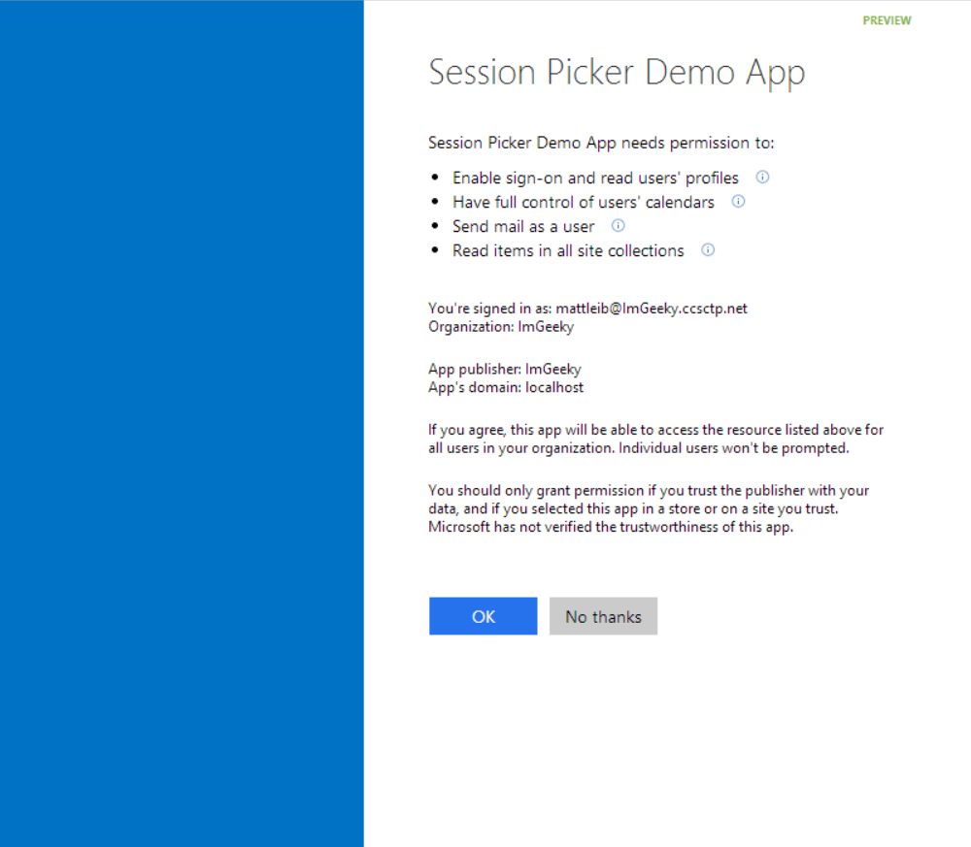
Common consent

Slide 7
Single authentication flow for Office 365
Azure AD graph, Exchange, SharePoint,…
Device apps and standalone websites
Admin and end-user consent

Slide 8
Secure protocol
OAuth 2.0
No capturing user credentials
Fine-grained access scopes
Supports MFA and federated user sign-in
Long-term access through refresh tokens

Slide 9
Office 365 discovery services
Automatically determine URL of O365 services
Supports device app and website flows
Secured using Azure AD authentication
Serves information stored about services in AAD

Slide 10
The SharePoint client APIs
Sites, Lists and Libs
Workflow
Search
Taxonomy
BCS
…
_api
Execute query
REST/ OData
JavaScript library
Silverlight library
.Net CLR library
Custom client code

Slide 11
Office 365 APIs Roadmap
Active Directory
Exchange & Outlook.com
SharePoint
OneDrive
Sites
OneDrive
Users
Mail
Calendar
Client API
OneDrive for Business
Sites, Lists and Libs
Taxonomy
Groups
Contacts
Workflow
BCS
Search
…

Slide 12
Getting Started

Slide 13
http://aka.ms/o365apis

Slide 14
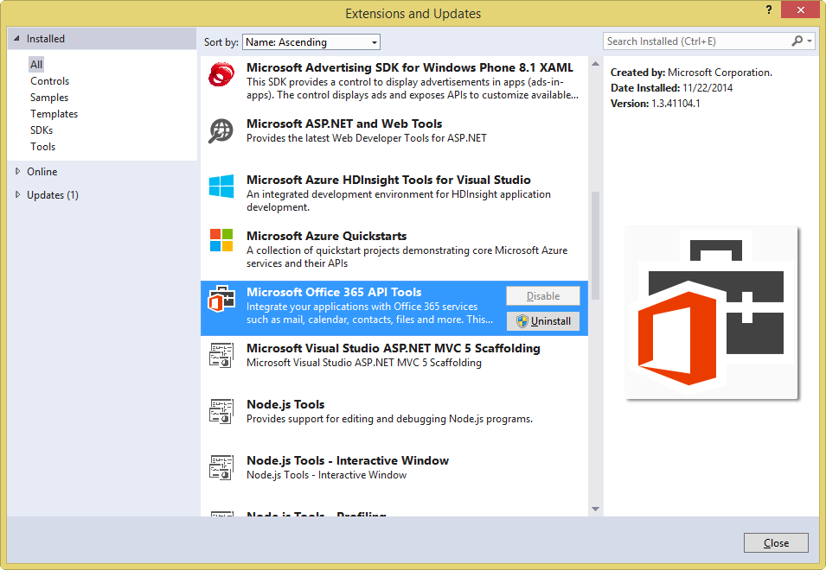
Get the tools

Slide 15
Visual Studio project support
.NET Windows Store Apps
Windows Forms Application
WPF Application
ASP.NET MVC Web Application
ASP.NET Web Forms Application
Xamarin Android and iOS Applications
Multi-device Hybrid Apps (Cordova)

Slide 16
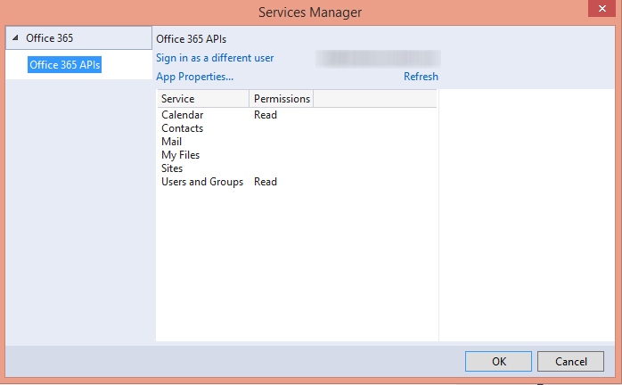

Slide 17
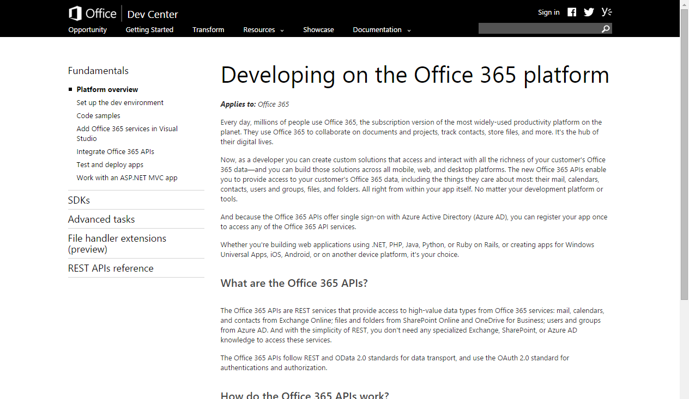
http://aka.ms/Office365DevAPIs

Slide 18
demo
Getting started Office 365 API tools for VS ASP.NET MVC

